Slide 1
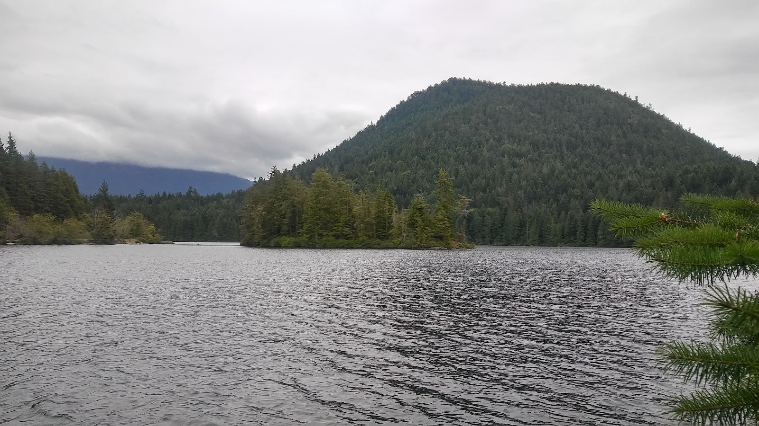








Predicting the presence of a hypolimnetic zone and whether it is hypoxic at large spatial scales
Richard LaBrie & Roxane Maranger

Slide 2
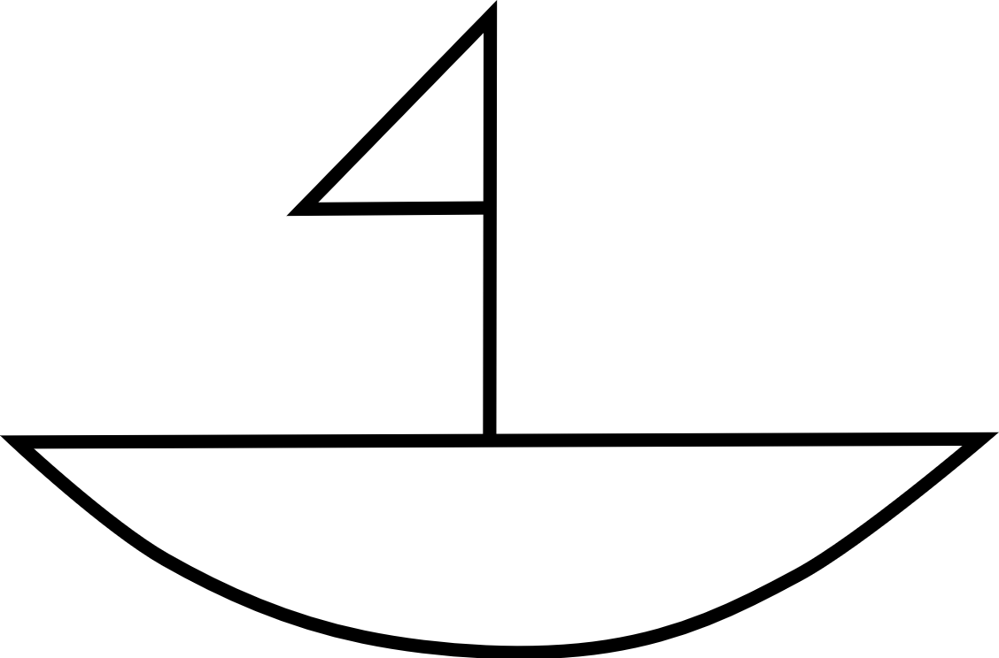
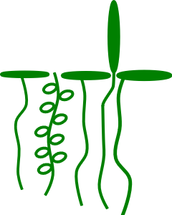
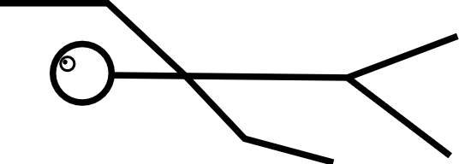
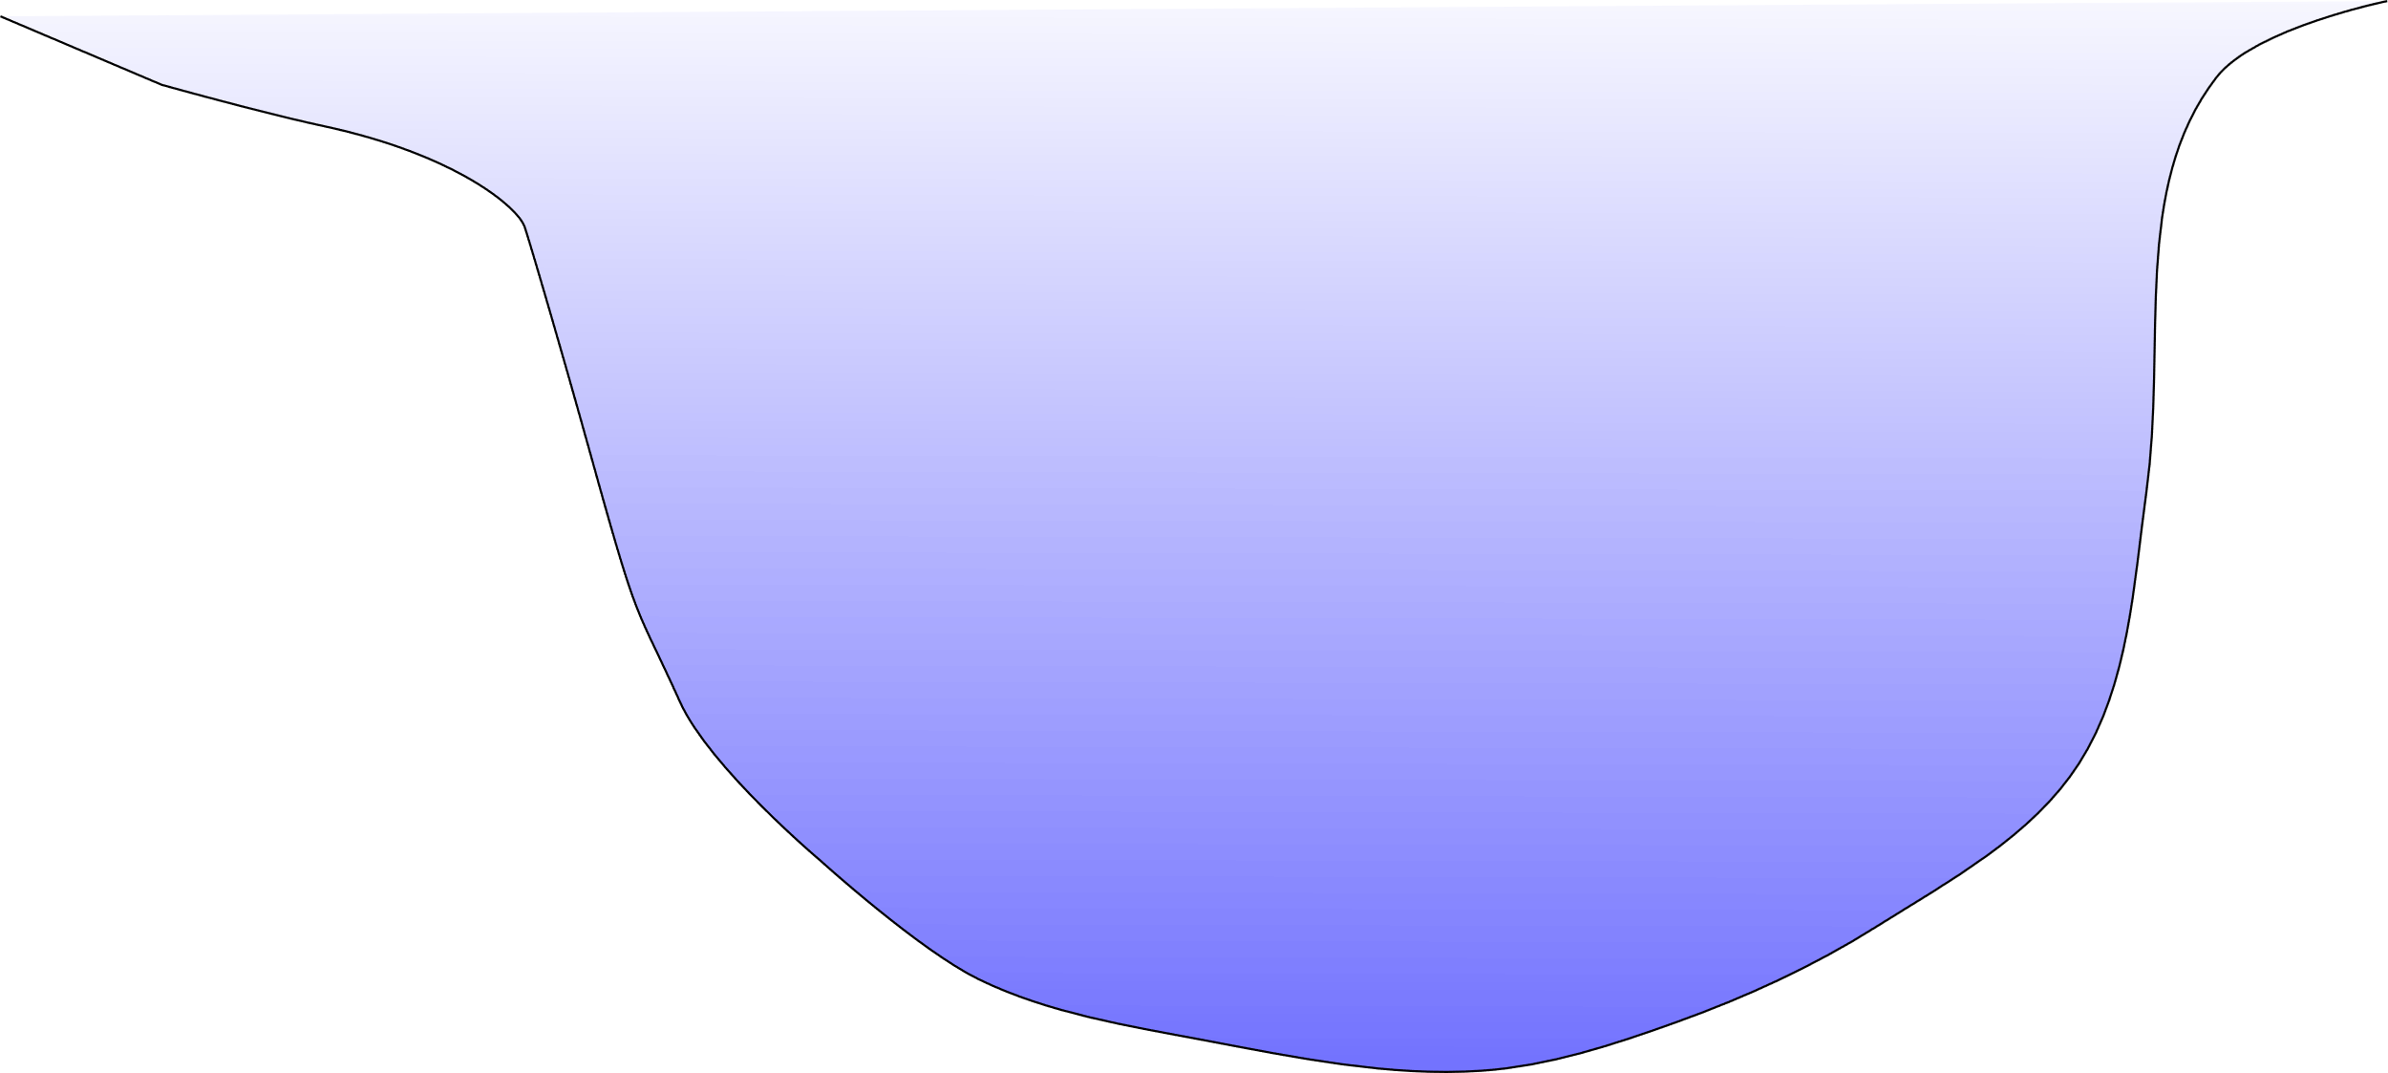
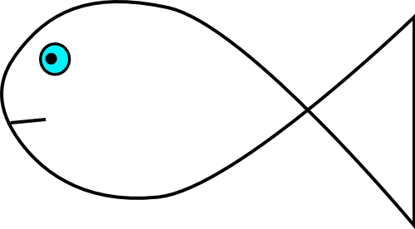
Ecosystem services

Slide 3
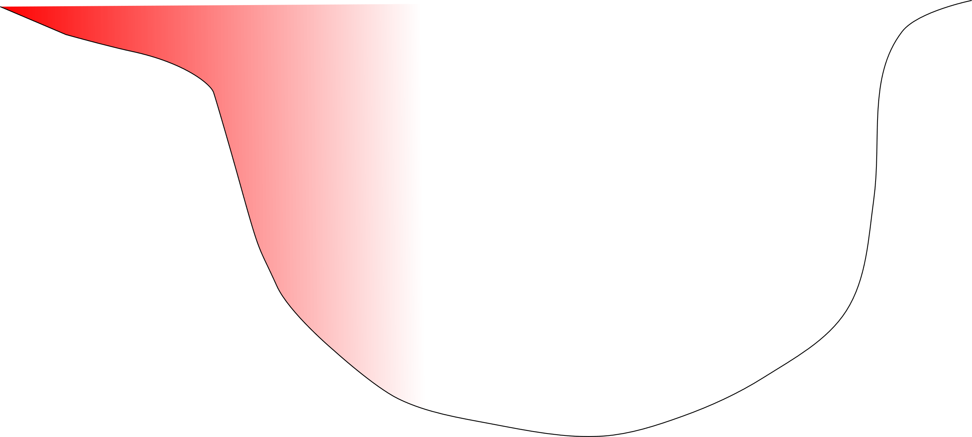
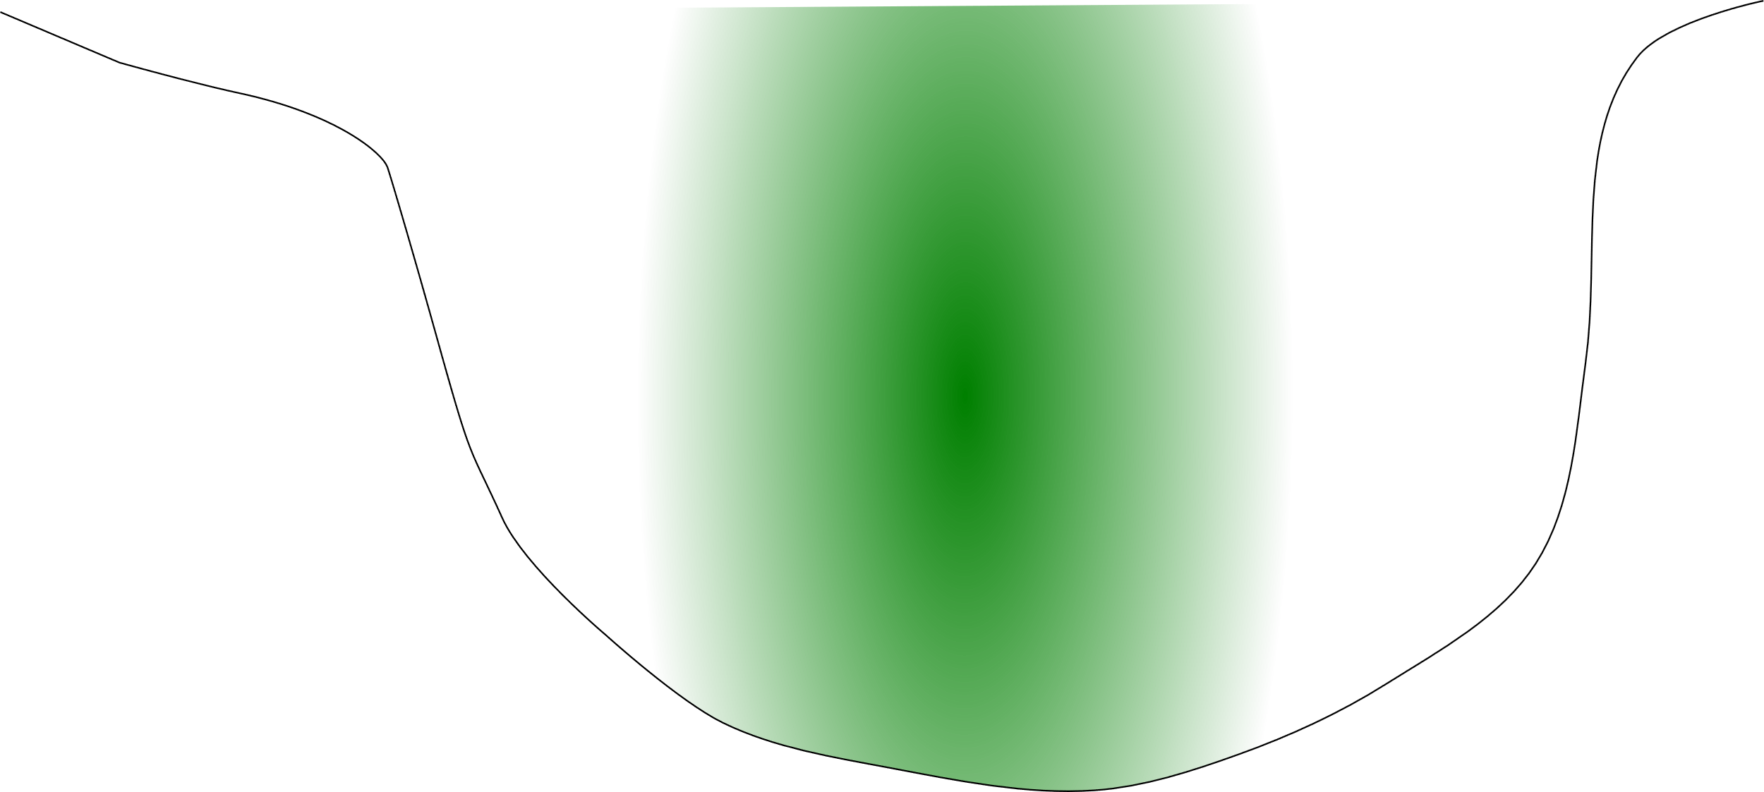
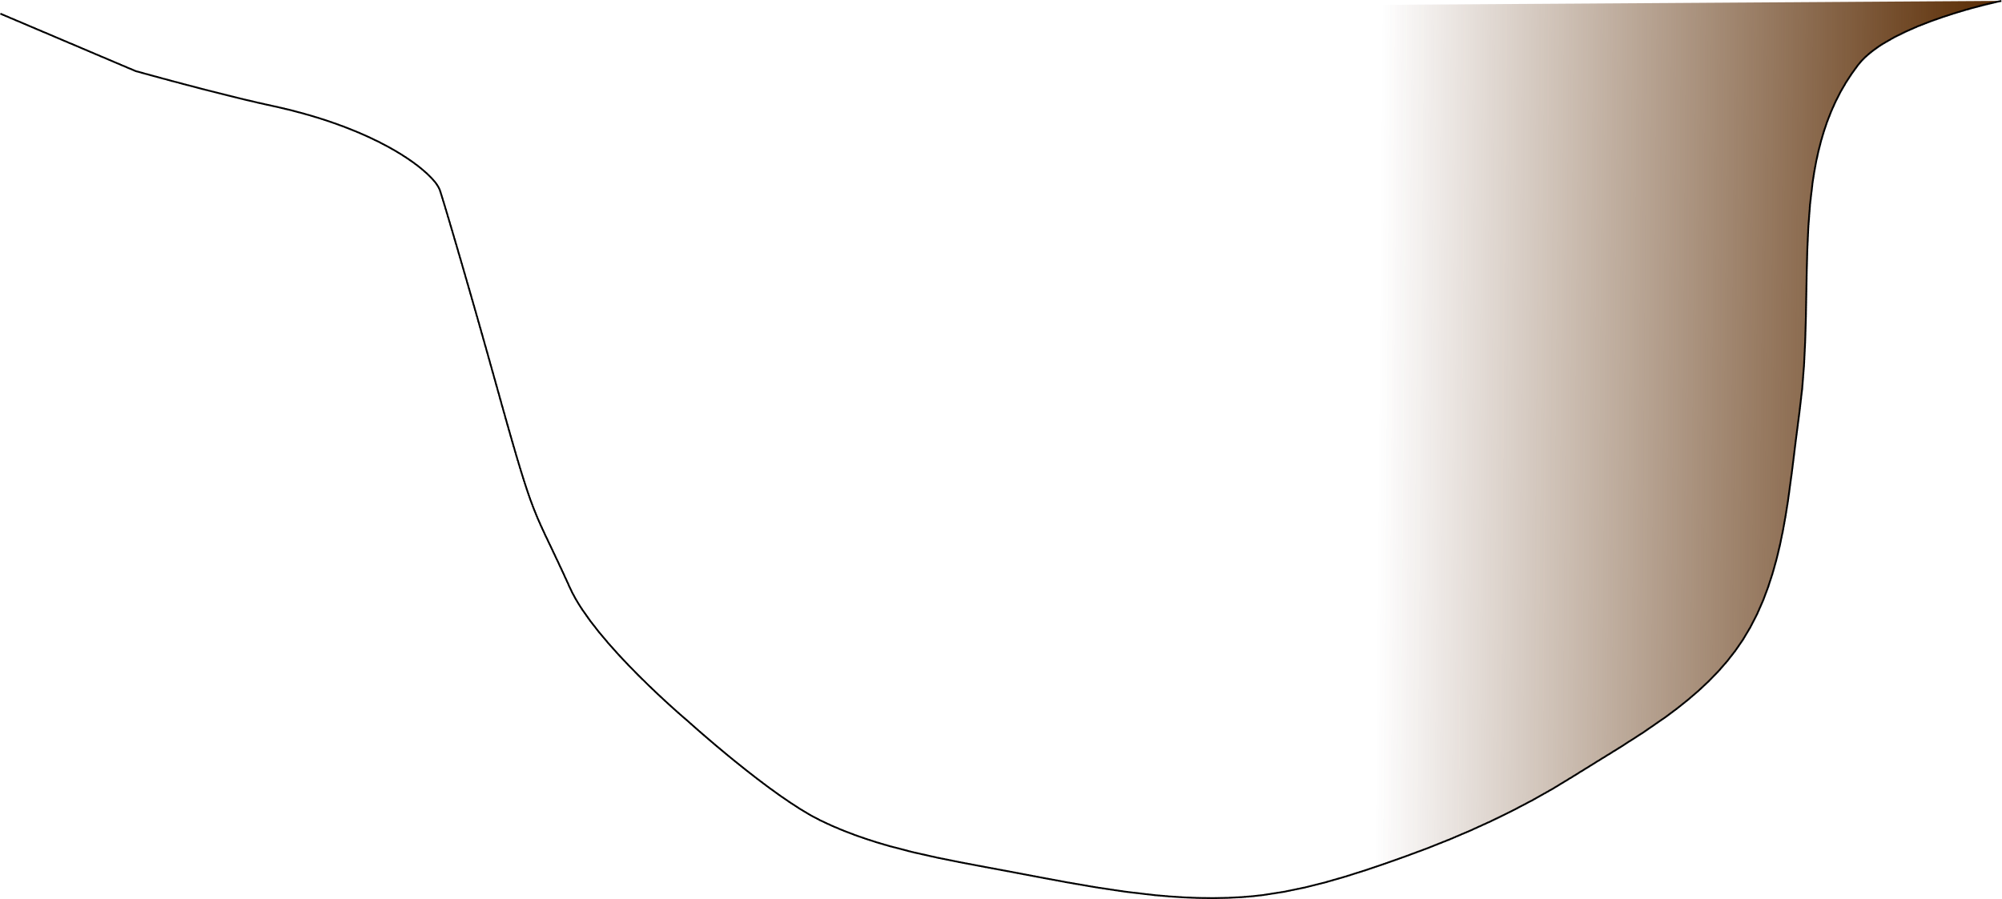
Human pressures on lakes
Climate change(T°)
Eutrophication (N-P)
Browning (DOC)

Slide 4
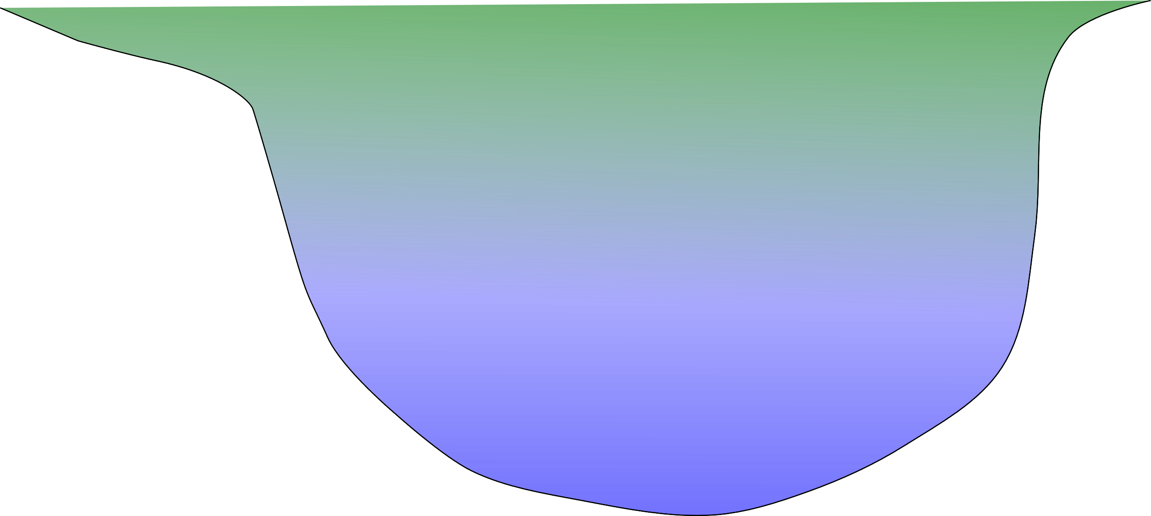
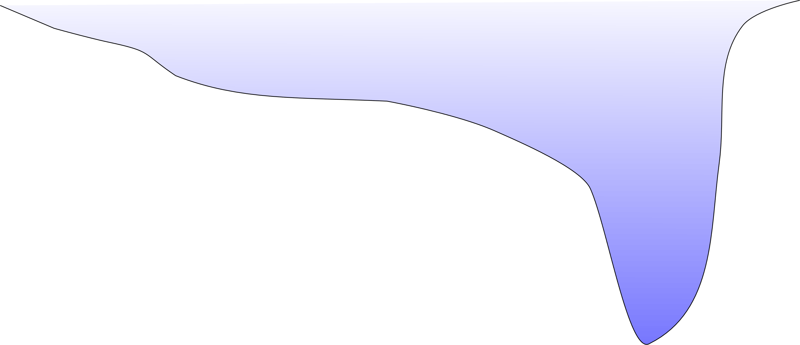
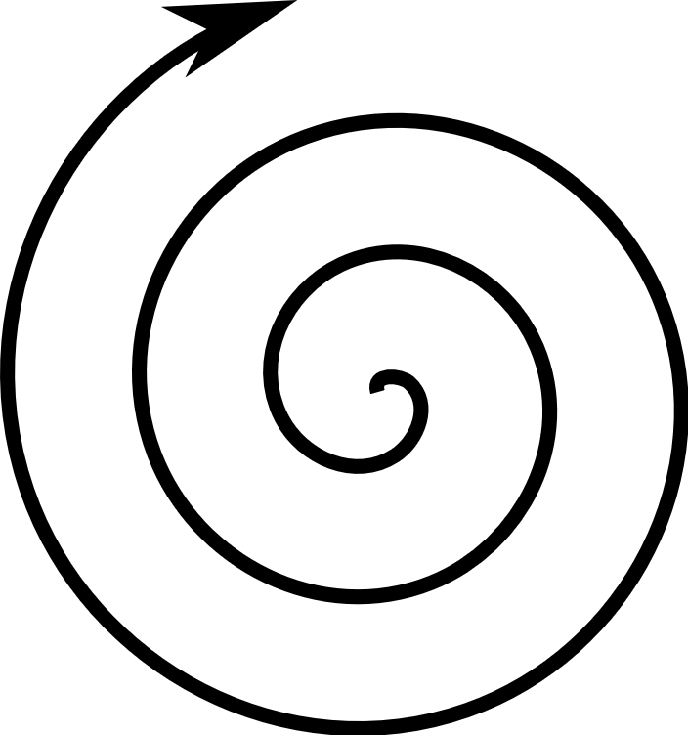
Regulating influence of morphometry
Resilience -
Resilience -
Resilience ++

Slide 5
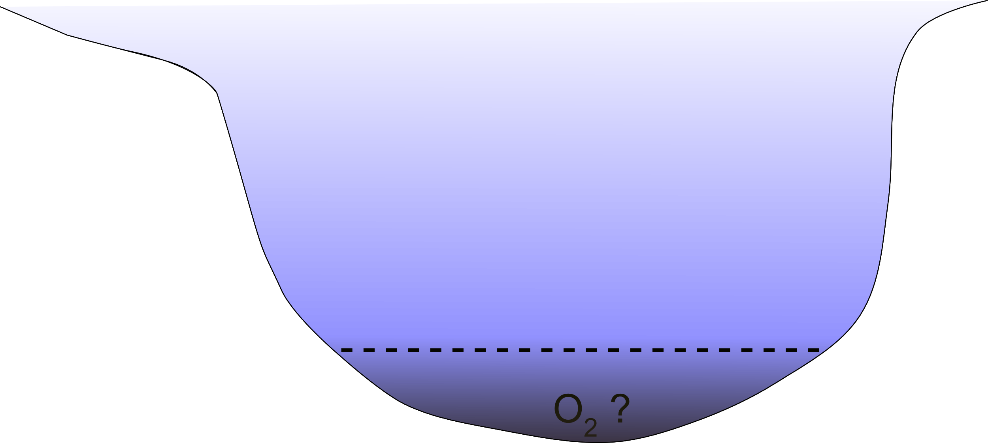
What determines the presence of an hypolimion and hypoxia at the continental scale

Slide 6
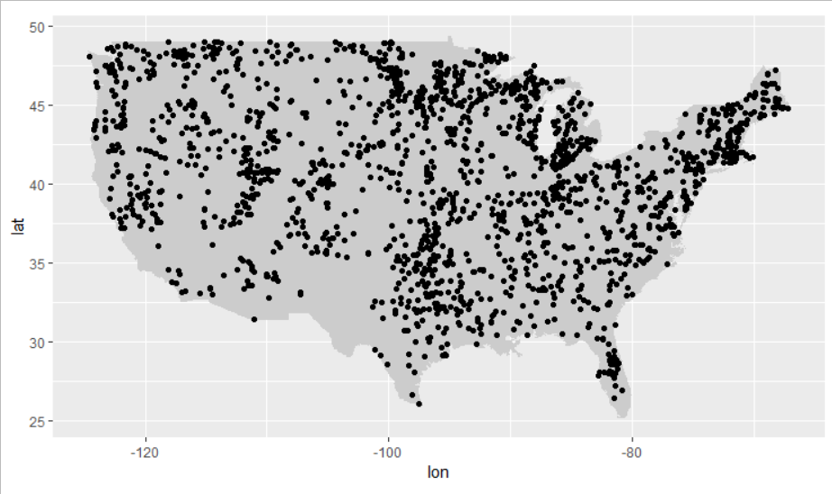
Methods: NLA 2007 and 2012

Slide 7
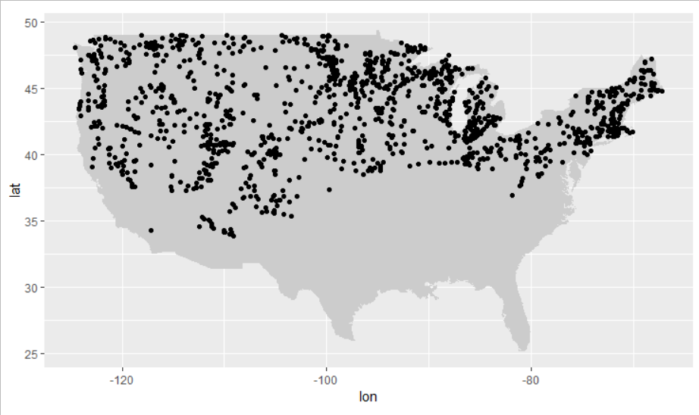
All lakes >40° latitude corrected for altitudes

Slide 8
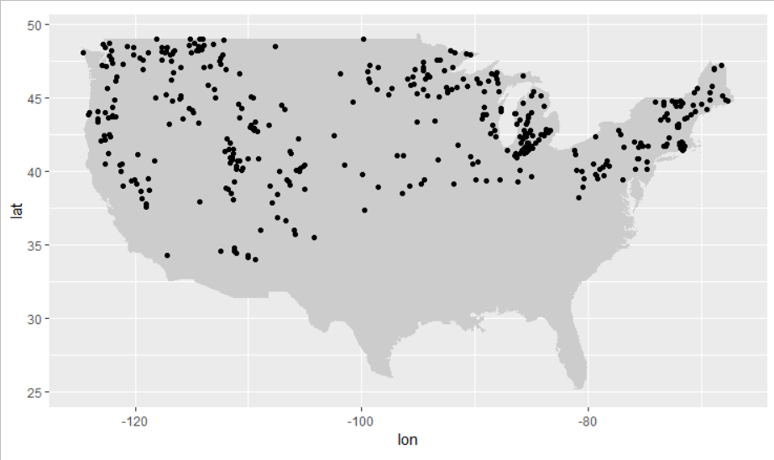
All lakes >40° corrected latitude and deeper than 2m

Slide 9
Methods
Basic morphometric, limnological and geographical variables
Random Forest with repeated k-fold cross validation
Sensitivity analysis
1. Can we predict the presence of an hypolimnion?
2. Can we predict the presence of hypoxia in lake with an hypolimnion?

Slide 10
1. Predicting the presence of an hypolimnion
Overall accuracy of the forest: 85.4%
Legend
Nr lakes
(% of lakes)
Good prediction
Bad prediction

Slide 11
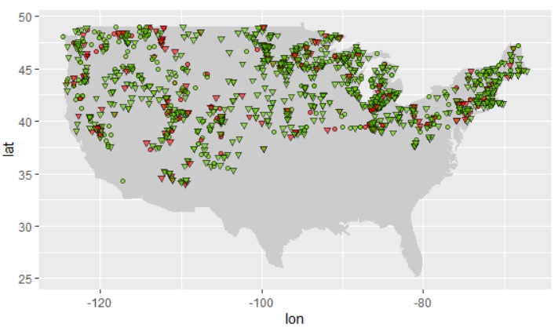
No spatial pattern
No hypolimnion
Hypolimnion
Good prediction
Bad prediction

Slide 12
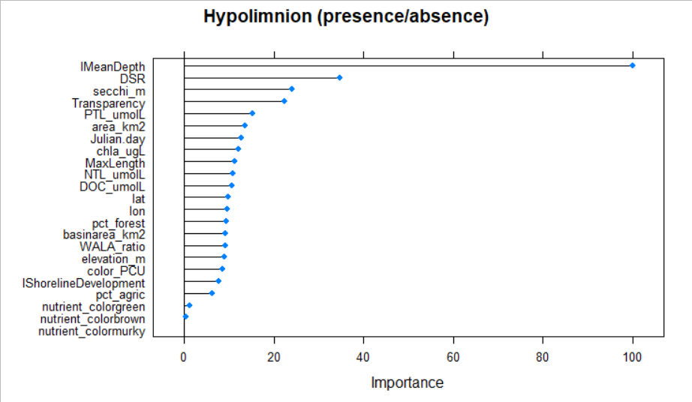
Hypolimnion is driven by morphology and water transparency
Notes:
Deeper lakes have a higher probability of developing a hypolimnion, which is why this variable drives the random forest. The general shape of the lake is also important. In order for a hypolimnion to develop, the lake should look more like a bowl than a plate. For water transparency, the deeper the secchi depth is, the more likely there will be a hypolimnion.

Slide 13
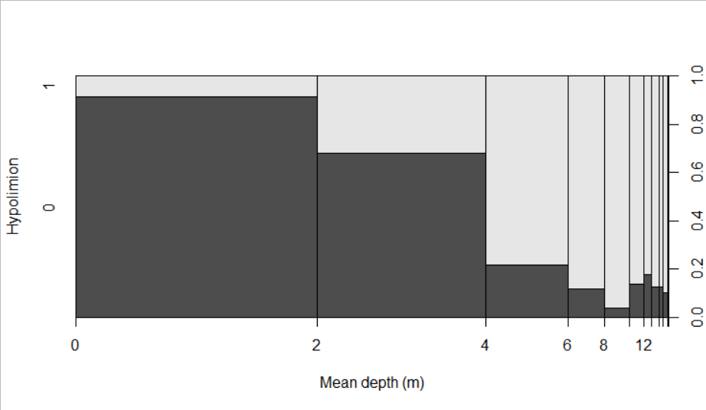
Deeper lakes have a higher probability to develop a hypolimnion
Yes
1
0.8
0.6
Lakes (%)
No
0.4
0.2
0

Slide 14
2. Predicting hypoxic conditions
Overall precision of the forest: 82%
Legend
Nr lakes
(% of lakes)
Good prediction
Bad prediction

Slide 15
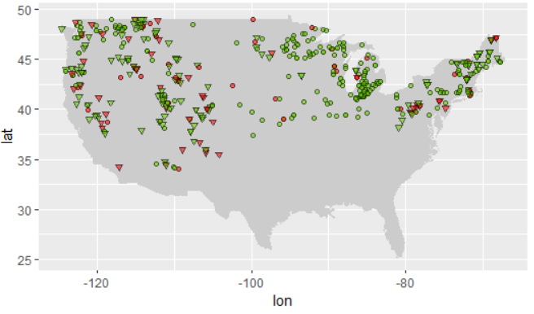
East-West spatial pattern
No hypoxia
Hypoxia
Good prediction
Bad prediction

Slide 16
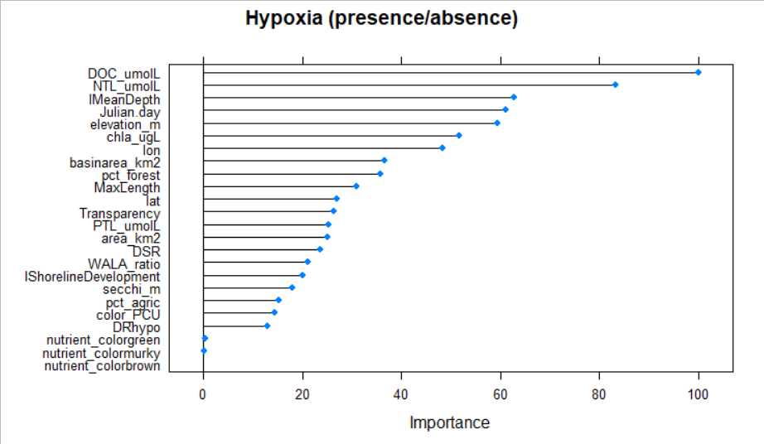
Hypoxia is driven by productivity

Slide 17
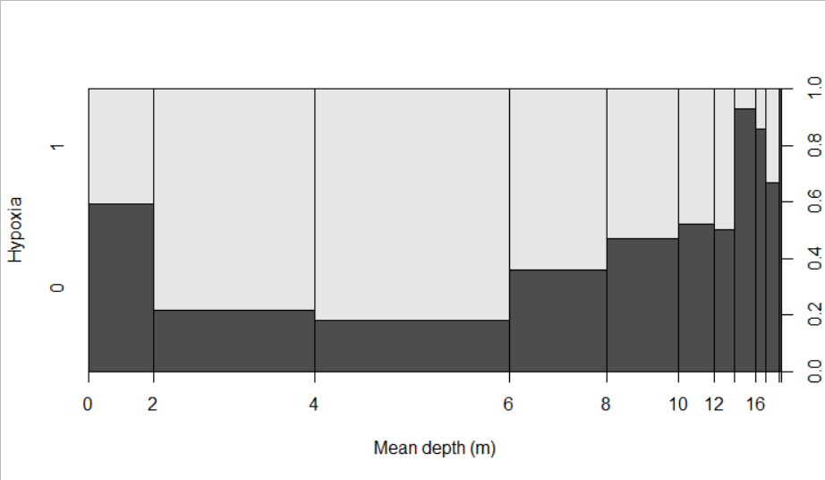
Shallow lakes are more prone to hypoxia
1
Yes
0.8
0.6
Lakes (%)
0.4
No
0.2
0

Slide 18
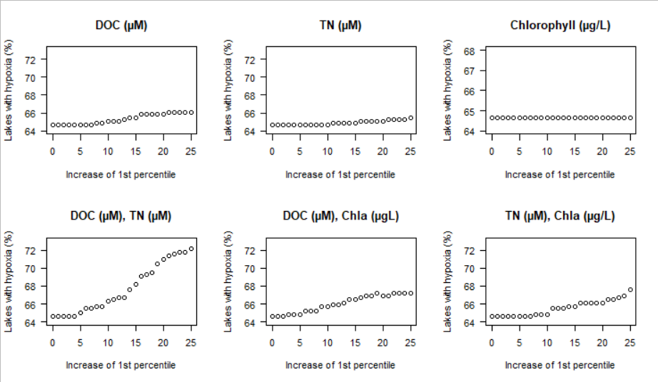
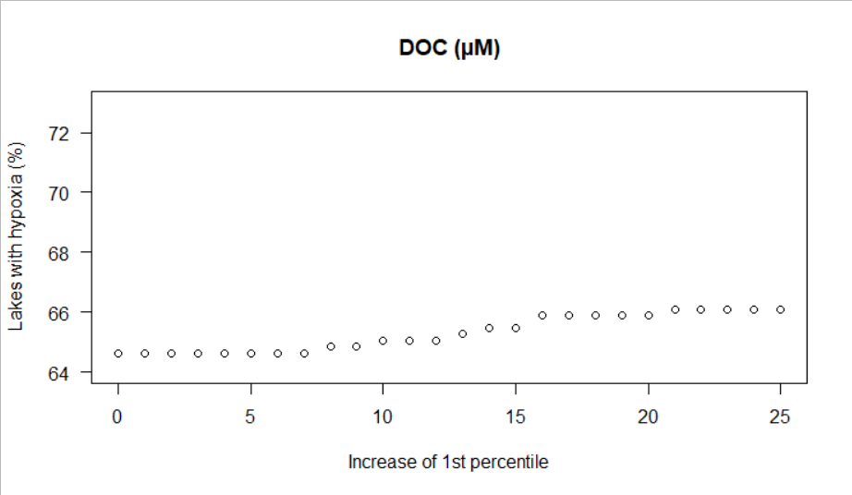
Exploring the forest: sensitivity analysis

Slide 19
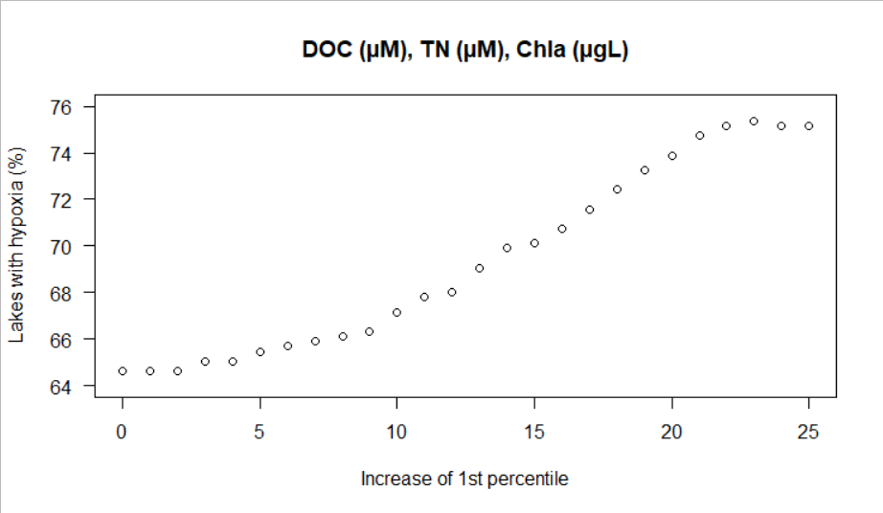
Synergistic effect of the three major contributors
50 lakes
~11%

Slide 20
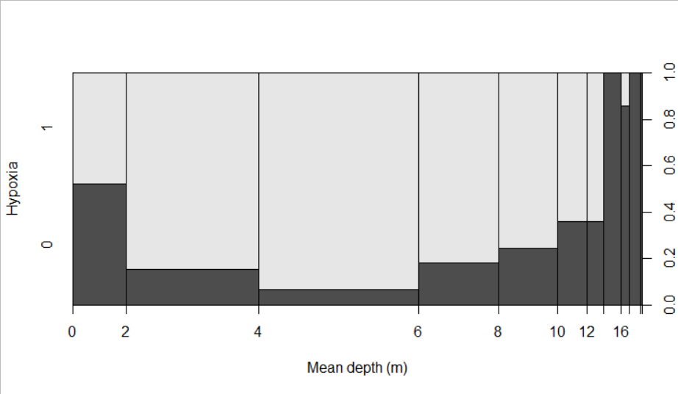
Distribution of hypoxia as a function of mean depth
1
Original data
0.8
Yes
0.6
Lakes (%)
0.4
No
0.2
0

Slide 21
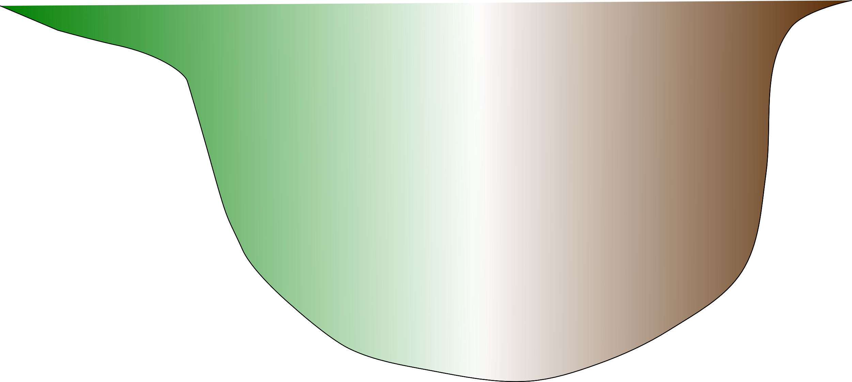
Take home
Mean depth is the strongest predictor for the presence of an hypolimnion, followed by lake’s shape
No hypolimnion
Hypolimnion
browning
greening
Lake productivity (C, N) drives hypoxia
O₂
Shallow lakes (2–6 m) are more prone to hypoxia
O₂
O₂

Slide 22
Acknowledgements
Nicolas Fortin St-Gelais
Lab colleagues
Photo credits: Andréanne Dupont
Funding sources
Mitacs
FRQNT
NSERC

